Slide 1
Genetic Algorithm
INFO6205 – Final Project
Problem Statement : Time Table Scheduling using genetic algorithm
Jay Nirmal
Karan Kathayat

Slide 2
Contents
Introduction
Time Table Scheduling
Genetic Algorithm
Implementation
Code Snippets
Running the code
Running the unit tests
Output
Conclusion
Results

Slide 3

Introduction
Consider you are trying to come up with a weekly timetable for classes in a college for a particular batch. We have to arrange classes and come up with a timetable so that there are no clashes between classes. Here, our task is to search for the optimum timetable schedule.

Slide 4
The genetic algorithm is a method for solving both constrained and unconstrained optimization problems that is based on natural selection, the process that drives biological evolution. The genetic algorithm repeatedly modifies a population of individual solutions and comes up with the best solution.
Five phases are considered in a genetic algorithm.
Initial population
Fitness function
Selection
Crossover
Mutation

Slide 5
Terminologies used for Genetic Algorithm
Individual – Possible solutions
Population - Set of all individuals
Search Space - All possible solutions to the specified problem
Chromosome – Blueprint for an individual
Trait - Possible aspect of an individual entity.
Allele - Possible settings for a trait
Locus - The position of a gene on the chromosome
Genome - Collection of all chromosomes for an individual entity

Slide 6
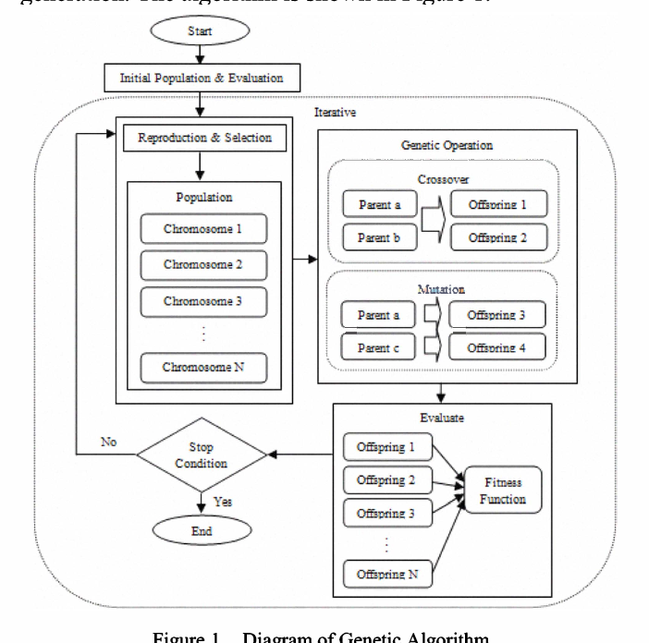
FLOWCHART

Slide 7
Implementation
Genes: An individual schedule is considered to be one gene.
Initial Gene: A randomly assigned individual schedule for a class.
Fitness Function: Genes are evaluated by counting the number of collisions. Fewer collisions presumably means a better solution gene.
Fitness function = 1 / (collisions + 1)
Selection:
Best Selection : The best gene is selected based on the fitness score. The fitness score for all genes is evaluated and compared and the gene with the best fitness is selected to be carried forward to the next generation.

Slide 8
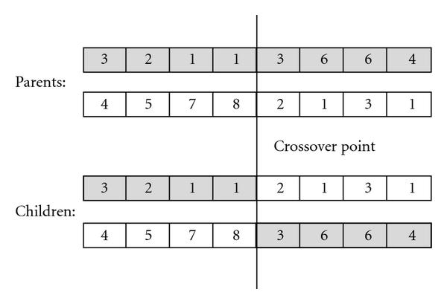
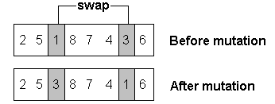
Implementation
Population: Indicates the number of genes in each generation.
Genetic Operators: Crossover or Mutation are chosen randomly for genes to produce a offspring.
Crossover: Performs crossover of two selected genes and produces a new gene.
Mutation: Performs mutation by swapping the digits in the gene array.

Slide 9
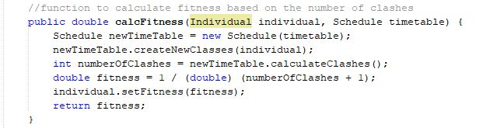
Code Snippets (Implementation)
Fitness function:

Slide 10
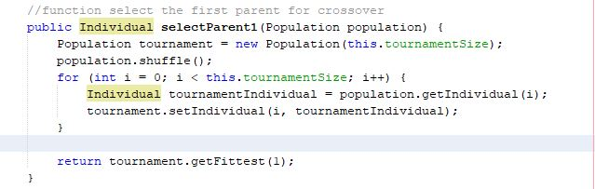
Code Snippets (Implementation)
Selection:

Slide 11
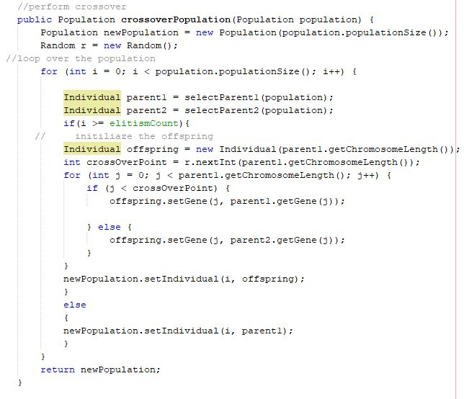
Code Snippets (Implementation)
GENETIC OPERATIONS
Selection

Slide 12
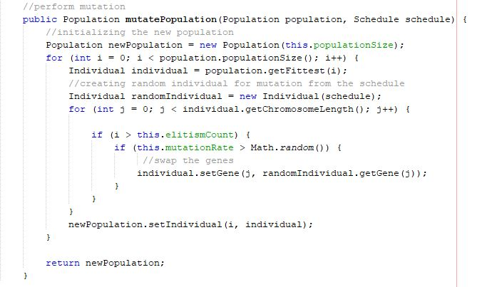
Mutation

Slide 13
Running the code
To run the program, we can directly run the Main method.
The following parameters can be modified in main method, which will affect the program working:
Population size : number of genes to consider in a population.
Initial Gene : the initial schedule is randomly assigned.
Iterations : Generations of chromosomes.

Slide 14
Running the Tests
Unit Tests have been developed for checking the following test cases:
For Time Table Scheduling:
Testing the fitness function.
Evaluating fitness for all genes
For Genetic :
Testing the mutation function.
Testing the crossover function.

Slide 15
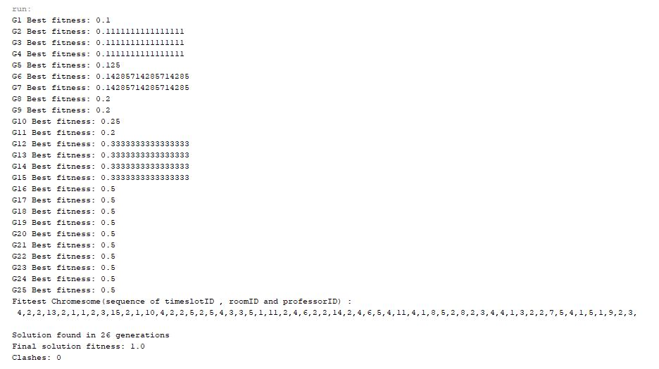
OUTPUT

Slide 16
Results
We noticed that the number of generations it took for the algorithm to find optimal solution fluctuate a lot depending on the population
After conducting test trials for the algorithm having population {20,1000}, the number of generations it took for our algorithm to achieve optimal solution greatly stabilized after crossing population count 100.
The execution time of the algorithm increases with increase in number of iterations.

